Slide 1

Movies Database using PostgreSQL
By: Syed Daniyal Ahmed Business Intelligence & Data Analyst

Slide 2
About Movies Database
A movie database is a structured system designed to store and manage information about films, actors, directors, genres, and user ratings.
Such databases are the backbone of real-world platforms like IMDb, Netflix, and Rotten Tomatoes, where millions of users interact with movie-related data daily.
To design and implement a relational database in PostgreSQL for storing movie-related data.
To ensure data integrity using primary and foreign key relationships.
To enable efficient querying for insights such as top-rated movies, movies by genre, and actor/director collaborations.
To demonstrate the use of SQL concepts (joins, subqueries, views, indexing) in real-world scenarios.
To create a foundation that can later integrate with visualization tools like Power BI for reporting and analytics.
By: Syed Daniyal Ahmed Business Intelligence & Data Analyst

Slide 3
Problem Statement
In the entertainment industry, massive amounts of data about movies, actors, directors, genres, and user ratings are generated every day. Without a proper database system:
Information becomes scattered and unorganized.
Data redundancy and inconsistency increase.
Retrieving insights (e.g., top-rated movies by genre, actor–director collaborations) becomes slow and inefficient.
Scaling for real-world applications like IMDb or Netflix becomes difficult.
By: Syed Daniyal Ahmed Business Intelligence & Data Analyst

Slide 4
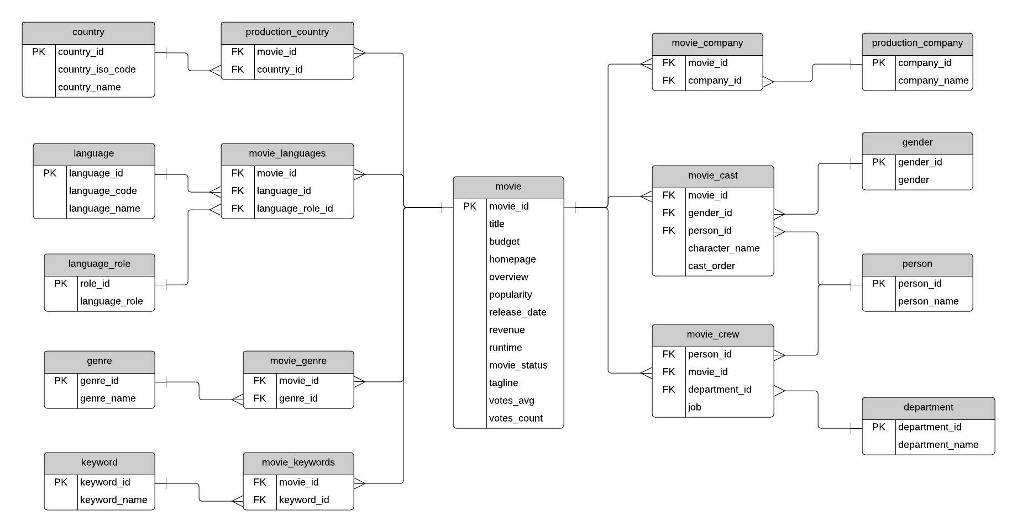
Dataset Overview
By: Syed Daniyal Ahmed Business Intelligence & Data Analyst

Slide 5
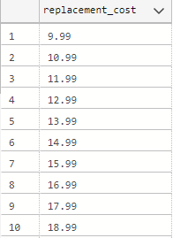
Task 01: Create a list of all the different (distinct) replacement costs of the films.
By: Syed Daniyal Ahmed Business Intelligence & Data Analyst

Slide 6
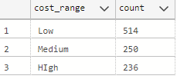
Task 02: Write a query that gives an overview of how many films have replacements costs in the following cost ranges. low: 9.99 - 19.99, medium: 20.00 - 24.99, high: 25.00 - 29.99
By: Syed Daniyal Ahmed Business Intelligence & Data Analyst

Slide 7
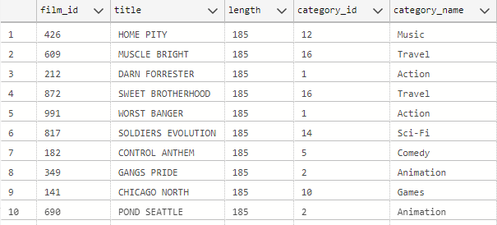
Task 03: Create a list of the film titles including their title, length, and category name ordered descending by length. Filter the results to only the movies in the category 'Drama' or 'Sports'.
By: Syed Daniyal Ahmed Business Intelligence & Data Analyst

Slide 8
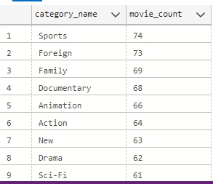
Task 04: Create an overview of how many movies (titles) there are in each category (name).
By: Syed Daniyal Ahmed Business Intelligence & Data Analyst

Slide 9
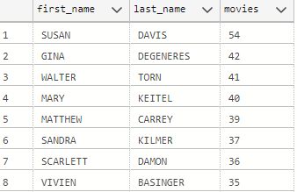
Task 05: Create an overview of the actors' first and last names and in how many movies they appear in.
By: Syed Daniyal Ahmed Business Intelligence & Data Analyst

Slide 10
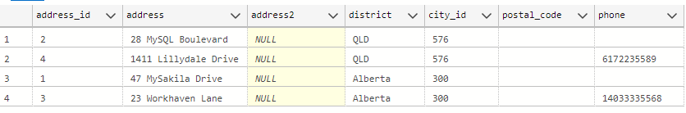
Task 06: Create an overview of the addresses that are not associated to any customer.
By: Syed Daniyal Ahmed Business Intelligence & Data Analyst

Slide 11
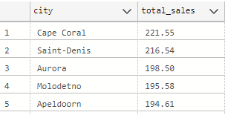
Task 07: Create an overview of the cities and how much sales (sum of amount) have occurred there.
By: Syed Daniyal Ahmed Business Intelligence & Data Analyst

Slide 12
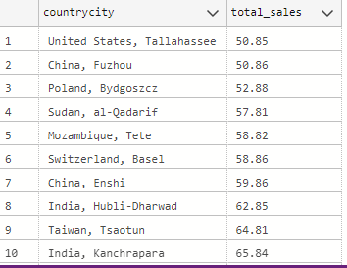
Task 08: Create an overview of the revenue (sum of amount) grouped by a column in the format "country, city".
By: Syed Daniyal Ahmed Business Intelligence & Data Analyst

Slide 13

Task 09: Create a list with the average of the sales amount each staff_id has per customer.
By: Syed Daniyal Ahmed Business Intelligence & Data Analyst

Slide 14

Task 10: Create a query that shows average daily revenue of all Sundays.
By: Syed Daniyal Ahmed Business Intelligence & Data Analyst

Slide 15

Task 11: Create a list of movies - with their length and their replacement cost - that are longer than the average length in each replacement cost group.
By: Syed Daniyal Ahmed Business Intelligence & Data Analyst

Slide 16
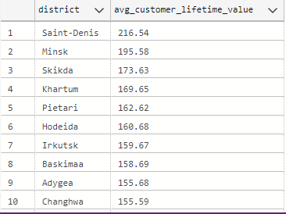
Task 12: Create a list that shows the "average customer lifetime value" grouped by the different districts.
By: Syed Daniyal Ahmed Business Intelligence & Data Analyst

Slide 17
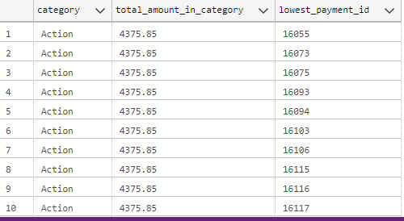
Task 13: Create a list that shows all payments including the payment_id, amount, and the film category (name) plus the total amount that was made in this category.
By: Syed Daniyal Ahmed Business Intelligence & Data Analyst

Slide 18
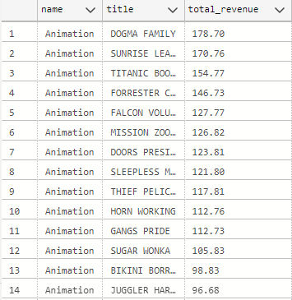
Bonus Query: Create a list with the top overall revenue of a film title (sum of amount per title) for each category (name).
By: Syed Daniyal Ahmed Business Intelligence & Data Analyst

Slide 19
Thank You
By: Syed Daniyal Ahmed Business Intelligence & Data Analyst

